Slide 1
PCP Visits Report TEST
File created on: 8/17/2026 12:29:38 PM

Slide 2
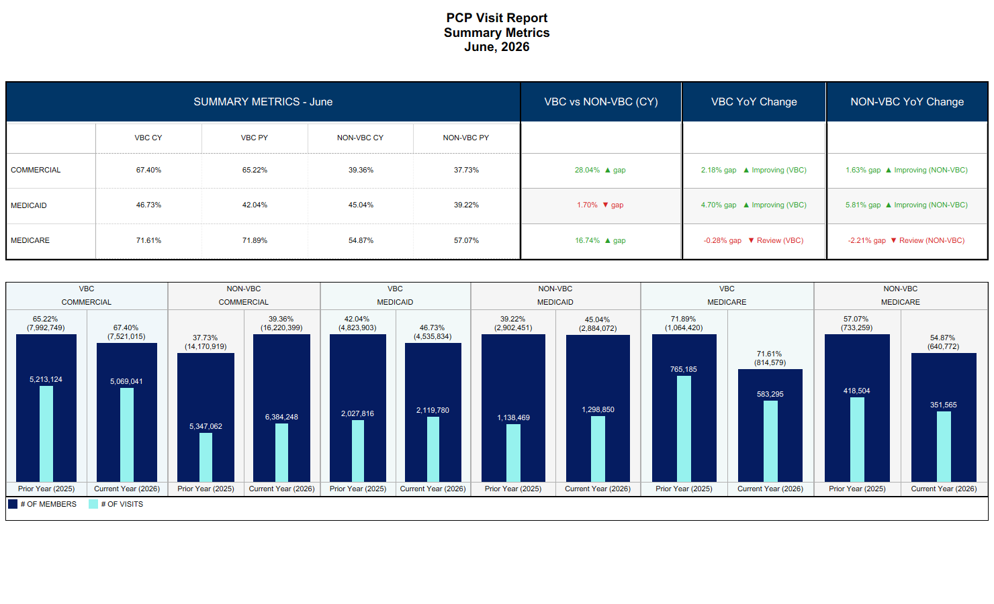

Slide 3
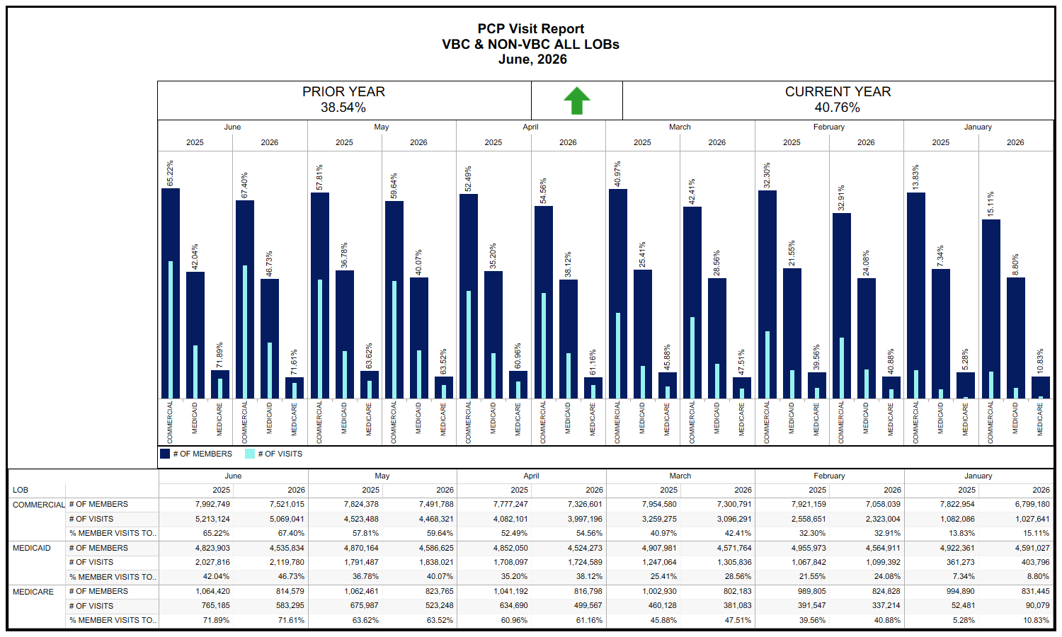

Slide 4
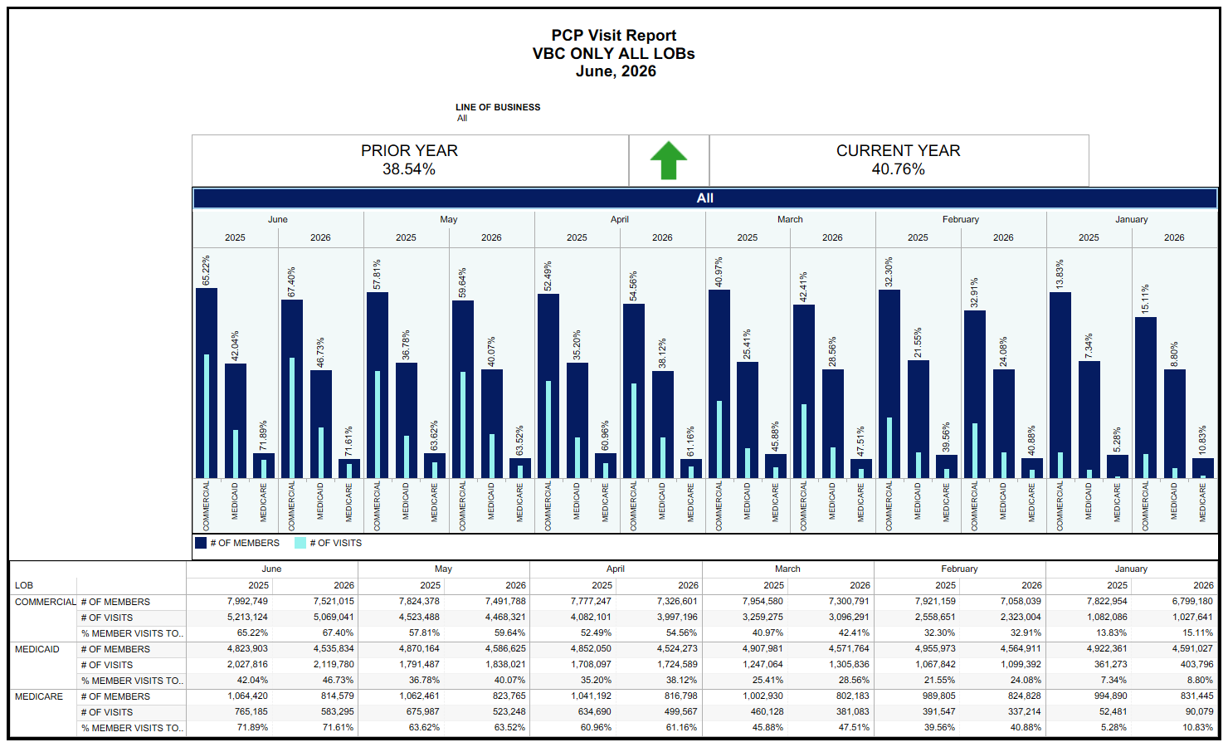

Slide 5
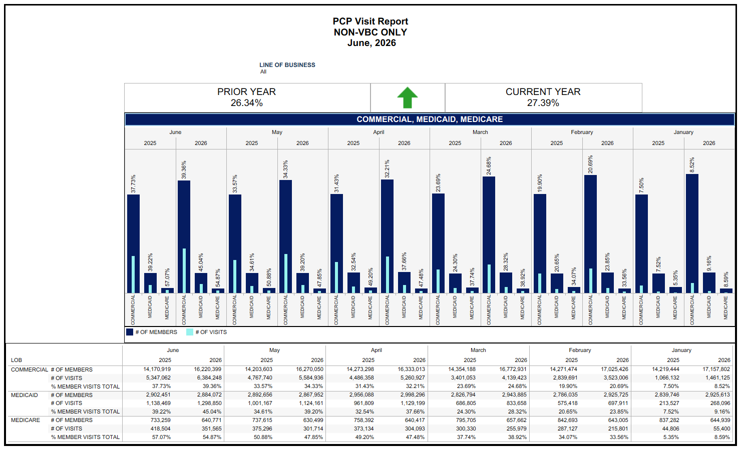

Slide 6
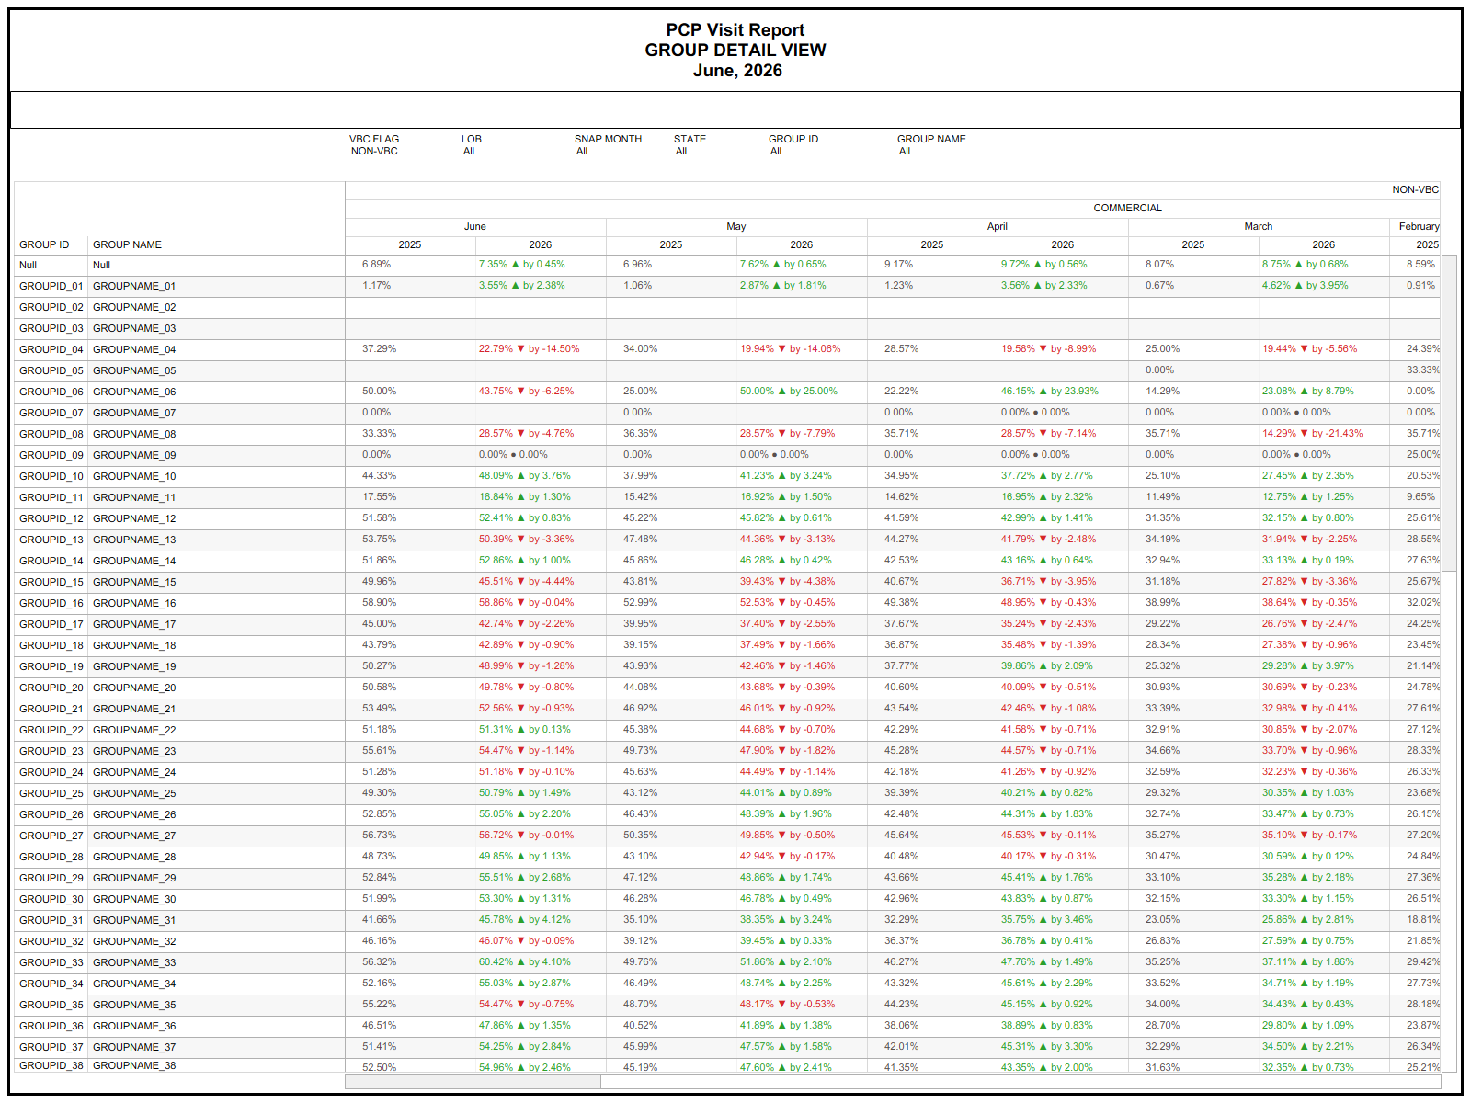

Slide 7
